Slide 1


Recognizing Intimate Partner Violence: Defensive Ulnar Fractures
David Sing^{1,2}, Rahul Gujrathi¹, Steven Seltzer¹, Giles Boland¹, George Dyer^{1,3},
Mitchel Harris^{1,4}, Paul Tornetta III², Bharti Khurana^{1*}
1. Trauma Imaging Research and Innovation Center, Department of Radiology
Brigham and Women’s Hospital, Harvard Medical School, Boston, MA, USA
2. Department of Orthopedics, Boston Medical Center, Boston, MA, USA
3. Department of Orthopedics, Brigham and Women‘s Hosptial, Boston, MA, USA
4. Department of Orthopedics, Massachusetts General Hospital, Boston, MA, USA
*Funding: Gillian Reny Stepping Strong Innovation award, Innovation Discovery award, BCRISP
Mass General Brigham

Slide 2
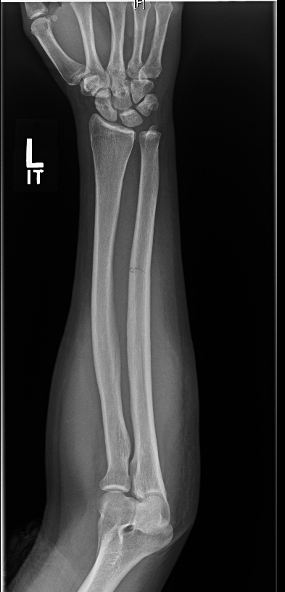
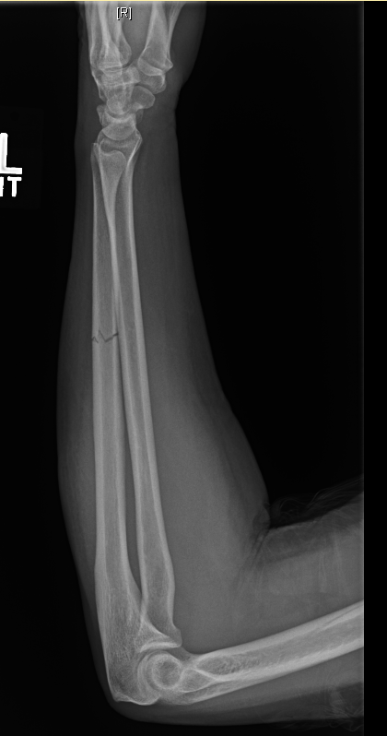
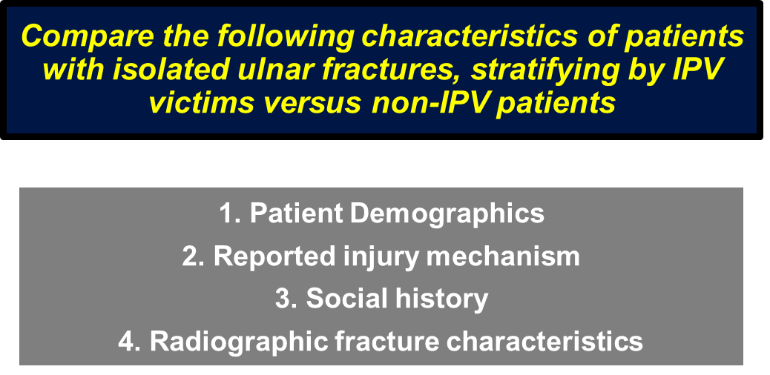

Objective
Notes:
I think the most difficult aspect of treating intimate partner violence is that recognizing it is hard. There aren’t guidelines or standardized references, and there is little-to-no education during medical school about it.
In my first 1st year orthopedic resident coming out of medical school, I evaluated a 34 year old female who reported she fell and the ED consulted for management of a forearm fracture. I thought, this is a nondisplaced isolated ulnar shaft fracture, and our radiologists agreed. That will do well in a cast, so I casted her and sent her out.
I know now we could have done a better job in taking a more thorough history or asking if she felt safe at home.
So there is clearly a need for improving IPV awareness especially among orthopedists and radiologists evaluating musculoskeletal injuries, and in particular noticing “defensive” fractures including ulnar shaft fracture.
Because patients are often not forthcoming regarding abuse, establishing more standardized reference guides using objective criteria may decrease the number of missed opportunities in helping IPV patients. The purpose of our study was to compare patient characteristics and radiographic features associated with isolated ulnar shaft fractures in IPV-related and non-IPV related cases.

Slide 3
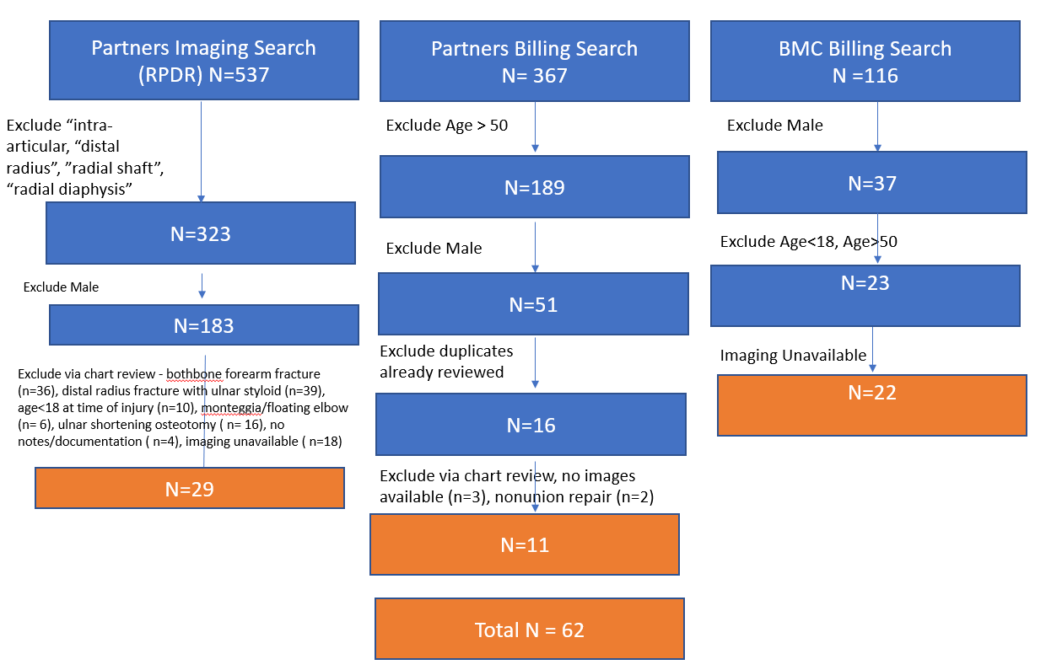
Methods
Multi-center, retrospectively queried electronic medical records from 6 hospitals from 2015-2019.
Inclusion criteria:
  Female, Age 18-50, isolated ulnar diaphyseal fractures with injury films
Exclusion criteria
  Polytrauma, pathologic fractures, pediatric patients
Notes:
Closed treatment of ulnar shaft fracture; without manipulation (25530)
Closed treatment of ulnar shaft fracture; with manipulation (25535)
Open treatment of ulnar shaft fracture, with or without internal or external fixation (25545)

Slide 4
Methods - data collection
  Charts reviewed for:
  - Age
  - Primary language
  - Race
  - Wealth index (composite measure of a household’s cumulative living standard based on patient ZIP code)
  - Marital status
  - Religion
  - Social history (alcoholism, depression/anxiety, IV drug abuse, homelessness)
  - Injury documented on facial exam
  - Screening for Intimate Partner Violence documented
  - Reported mechanism of injury (Assault, Collision with Object, Fall, Motor Vehicle Collision, Pedestrian Struck)
  - Number of documented Emergency Department visits
Notes:
Data was collected encompassing patient demographics and social history risk factors, as well as injury documentation on facial exam, whether or not screening for IPV was performed, the reported mechanism of injury, and number of documented ED visits

Slide 5
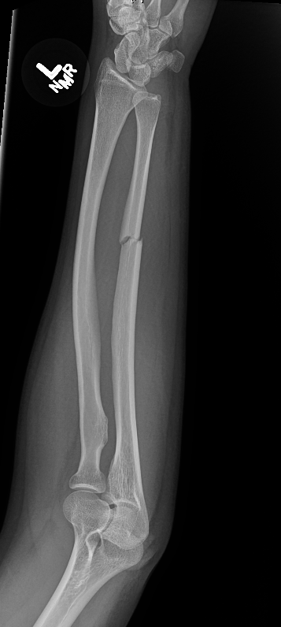
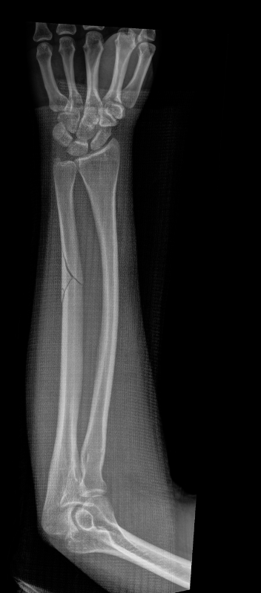
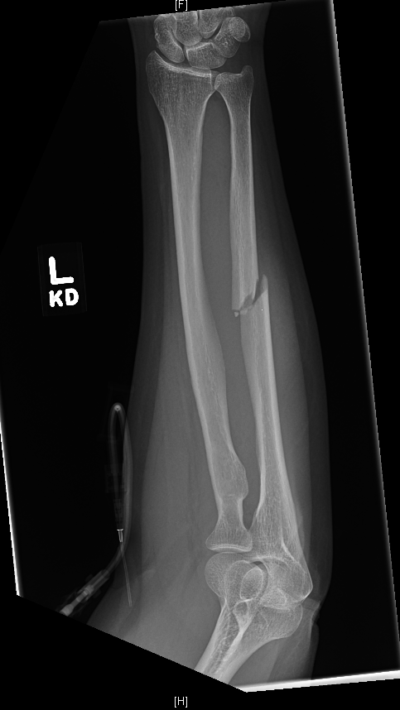
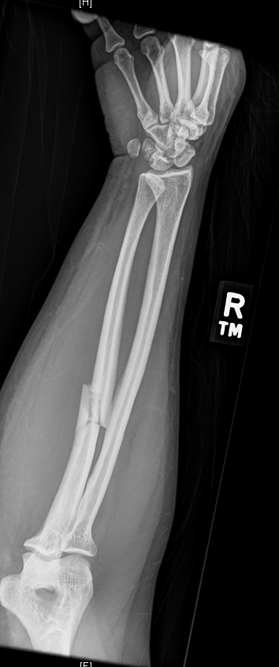
Methods - image analysis
2 views of forearm x-rays at time of injury were evaluated for:
1) Fracture location: Distal, Midshaft, Proximal, Metadiaphyseal
2) Fracture orientation: Transverse, Transverse + Butterfly, Oblique/spiral, Comminuted
3) Fracture displacement: <50% translation, <10 deg angulation

Slide 6
Methods - stratification
Patients stratified based on self-reporting and/or EMS documentation from initial ED or clinic intake visit into four groups:
1. Confirmed IPV
2. Suspected IPV
3. Suspected UNRELATED to IPV
4. Confirmed UNRELATED to IPV
2 sets of cohorts were compared:
  Confirmed: (Group 1 versus Group 4)
  Confirmed and Suspected: (Group 1 + 2 versus Group 3 + 4)
Statistical analysis using chi-squared and t-testing
Notes:
Suspected: Mechanism of injury reported did not match the fracture pattern,
Inconsistent history given to different providers, EMS story did not line up with patient’s story

Slide 7
Results - demographics and patient history
62 patients
  12 confirmed IPV
  8 suspected IPV
  8 suspected not IPV
  34 confirmed not IPV
Mean age 31
High rate of Depression
Homelessness significantly greater in IPV groups

Slide 8
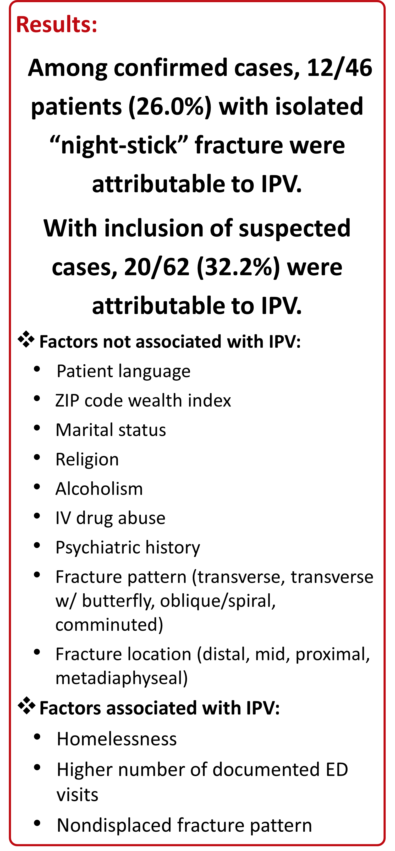
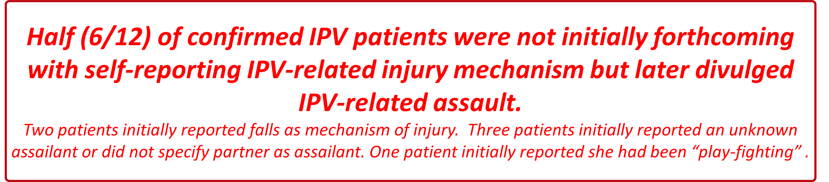

Results
Notes:
20/62 = 32.2% including suspected cases

Slide 9
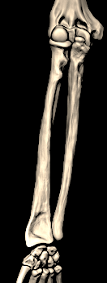
Results - Injury location
IPV versus NonIPV
0% vs 11.8%
58.3 % vs 41.2%
25.0% vs 26.5%
16.7% vs 20.6%

Slide 10
Results

Slide 11
Longitudinal Imaging Analysis
A longitudinal (historical) image analysis was performed in all the patients with all available radiological studies
These injuries were graded as low, intermediate and high probability of IPV on all the historical imaging available for patient
High suspicion was raised in 7/12 patients with multiple prior injuries at different times involving extremities and/or face on previous or follow-up radiological studies
Moderate suspicion was raised in 2/12 patients due to multiple negative previous musculoskeletal radiographs performed at different times
No suspicion was raised in 3 patients

Slide 12
Comparison of Imaging data prediction of IPV with the clinical charts
IPV Suspicion | Clinical Chart Review | Historical Imaging Analysis (moderate to high)
Confirmed IPV | 12 | 9
Possible IPV | 8 | 3
Probably no IPV | 8 | 3
Confirmed no IPV | 34 | 2
Notes:
A total of 381 radiological studies were performed in 20 confirmed victims for a median number of 28 studies per patient and a range of 5 to 60. For 7 suspected IPV victims, a total of 147 radiological studies were performed with a median of 7 and a range of 1 to 80 studies. For 34 confirmed no IPV patients, there were 875 studies with a median of 18 and a range of 2 to 94 studies. For 8 probably not IPV patients, 108 studies were performed with a median of 11 and a range of 2 to 37 studies.

Slide 13
Performance Metrics of historical imaging analysis
Performance metrics of historical imaging analysis with confirmed clinical suspicion
Clinical | Historical Imaging Analysis (moderate to high)
Confirmed IPV (12) | TP=9 | FN=3
Confirmed no IPV (34) | FP=2 | TN=32
Sensitivity: 75% [95% CI 43%, 95%] Specificity: 94% [80%, 99%] PPV: 81% [48%, 98%] NPV: 91.4% [77%, 98%]
Performance metrics of historical imaging analysis with combined suspicion (definite and possible)
Clinical | Historical Imaging Analysis (moderate to high)
Confirmed or possible IPV (20) | TP=12 | FN=8
Confirmed or probably no IPV (42) | FP=5 | TN=37
Sensitivity: 60% [95% CI 36%, 81%] Specificity: 88% [74%, 96%] PPV: 71% [44%, 90%] NPV: 82% [68%, 92%]
Notes:
Table 1: Sensitivity: 75% [95% CI 43%, 95%] Specificity: 94% [80%, 99%] PPV: 81% [48%, 98%] NPV: 91.4% [77%, 98%]
Table 2: Sensitivity: 60% [95% CI 36%, 81%] Specificity: 88% [74%, 96%] PPV: 71% [44%, 90%] NPV: 82% [68%, 92%]

Slide 14
Limitations
Presumed low-energy mechanism causing nondisplaced fracture is difficult to definitively conclude IPV
Requires further study and larger sample size
“Suspected” criteria can be subjective
Follow-up is needed to evaluate outcome of patients
Association with other injuries/imaging patterns may additionally aid in diagnosis
Automated identification of injury patterns that may be high-risk for IPV would more effectively improve awareness
All injuries in the cohort attributed to IPV with no control population. However, it is very difficult to establish a control population for IPV, considering the significantly low proportion of patients disclosing such a history.
Performance metrics of longitudinal imaging analysis may improve IPV detection

Slide 15
Conclusions
Up to one-third of adult women sustaining isolated ulnar shaft fractures may be caused by IPV
Screening for IPV at initial injury remains uncommon
Looking out for a high number of ED visits, lack of domicile, and nondisplaced fracture pattern may also help in identifying potential victims
Radiologists can help patients in this dangerous circumstance and should maintain a high degree of suspicion of IPV when identifying isolated ulnar shaft fractures, particularly if they are minimally displaced.

