Slide 1

Morphologic, Microstructural, and Connectomic Correlates of Attention-Deficit/Hyperactivity Disorder in Adolescents
Huang Lin, postgraduate fellow
Department of Radiology,
Yale School of Medicine
Huang.lin@yale.edu

Slide 2
Disclosure
Conflict of interest: None

Slide 3
What is ADHD?
Neurodevelopmental disorder of childhood
Often last into adulthood
Effected children often have struggles with concentration, controlling impulsive behavior or being overactive
  Some children also have these problems without ADHD, but what is the difference?
  -> symptoms persist overtime
  Difficulties in school, jobs and with other people (friends, family…)

Slide 4
causes OF ADHD
CAUSES AND RISK FACTORS ARE UNKNOWN
GENETIC, BRAIN INJURIES, EXPOSURE TO ENVIRONMENTAL RISK, PREMATURE BIRTH ARE POSSIBLE CAUSES
ADHD IS MARKED BY DYSFUNCTIONAL FUNCTIONAL NETWORKS IN THE BRAIN AND ALSO STRUCTURAL CHANGES
  -> WE TAKE A DEEPER LOOK IN THIS PART

Slide 5
OUR WORK
We want to investigate microstructural and functional connectivity correlated with ADHD on brain Magnetic Resonance Imaging (MRI) scans of adolescents
To evaluate the applicability of machine learning in predicting ADHD diagnosis
Notes:
The main goal of our research was to determine the neuroimaging microstructural, morphological, and functional connectivity correlates of ADHD in adolescents

Slide 6
Methods I – Our data
Database: ABCD (https://abcdstudy.org/)
  1830 with and 6067 adolescents without ADHD
  Multicenter, overtime study
  Reflecting the US population
Multivariate regression analysis with diagnosis of ADHD as outcome to investigate structural and functional changes
Combination of machine learning classifiers and feature selection algorithms to evaluate prediction
Notes:
For this purpose, we used the Adolescent Brain Cognitive Development datset of 11,876 adolescents. It is a multicenter, longitudinal study. As the first step we perform several multivariate analysis with age, sex, highest parental education, handedness and

Slide 7

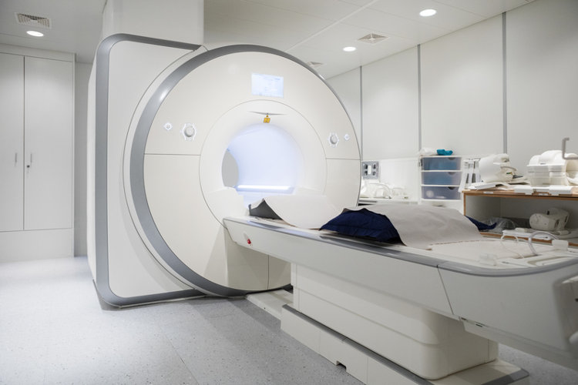
Methods II – What is an MRI?
A non-invasive imaging technique to see the brain
Use a magnetic field to create pictures of organs and tissues in the body
Different sequences existing to emphasize different aspects of the brain: the structure, the connection of the different regions and the activity
https://www.mydr.com.au/tests-investigations/mri-scan-magnetic-resonance-imaging/

Slide 8
Methods III – what are we looking at ?
Diffusion weighted imaging for identifying white matter integrity
  To see the white matter which is the structure connecting the different areas of the brains
  Representing the axon of a brain cell
T1-weighted structural imaging
  See the surface area of the brain, the volume, the thickness and how deep the fissures are
Resting-state functional MRI
  With this we can see the active area in the brain when we are at rest
Clinical assessments
  Different questionnaires where we ask the patient about their diagnosis, age, sex, ethnicity, their household income and which hand they prefer to use

Slide 9
Demographics description
Demographics description
 |  | with ADHD | without ADHD | Total | P-value
 |  | 1798 | 6007 | 7805
Age (in months) |  |  |  |  | 0.8315¹
 | Mean (SD) | 119.5 (7.5) | 119.3 (7.6) | 119.3 (7.55)
 | Min-Max | 107-132 | 107-133 | 107-133
 | Median (IQR) | 120 | 119 | 119
Sex, n (%) |  |  |  |  | < 2.2e-16²
 | Female | 654 (36.4) | 3224 (53.7) | 3878 (49.7)
 | Male | 1144 (63.6) | 2783 (46.3) | 3927 (50.3)
Race, n (%) |  |  |  |  | 0.0006532²
 | White | 997 (55.5% ) | 3324 (55.3) | 4321 (55.4)
 | Black | 293 (16.3) | 818 (13.6) | 111 (14.2)
 | Asian | 21 (1.2) | 136 (2.3) | 157 (2.0)
 | Hispanic | 325 (18.1) | 1244 (20.7) | 1569 (20.1)
 | Undetermined | 6 (0.3) | 17 (0.3) | 23 (0.3)
 | Mixed/Others | 156 (8.7) | 468 (7.8) | 624 (8.0)
Handedness, n (%) |  |  |  |  | 3,46e-05²
 | Right | 1388 (77.2) | 4912 (81.8) | 6300 (80.7)
 | Left | 137 (7.6) | 406 (6.8) | 543 (7.0)
 | Both | 273 (15.2) | 689 (11.5) | 962 (12.3)
Highest parental education, n (%) |  |  |  |  | 1,91e-03²
 | No Highschool Degree | 96 (5.3%) | 345 (5.7) | 441 (5.7)
 | Highschool/ General Educational Development | 139 (7.7) | 482 (8.0) | 621 (8.0)
 | Some college/ Associate Degree | 534 (29.7) | 1439 (24.0) | 1973 (25.3)
 | Bachelor's Degree | 483 (26.9) | 1559 (26.0) | 2042 (26.2)
 | Postgraduate | 543 (30.2) | 2177 (36.2) | 2720 (34.8)
 | Undetermined | 3 (0.2) | 5 (0.1) | 8 (0.1)
[PS1]Add percentage % sign to the values in the Table instead of explaining in the caption

Slide 10

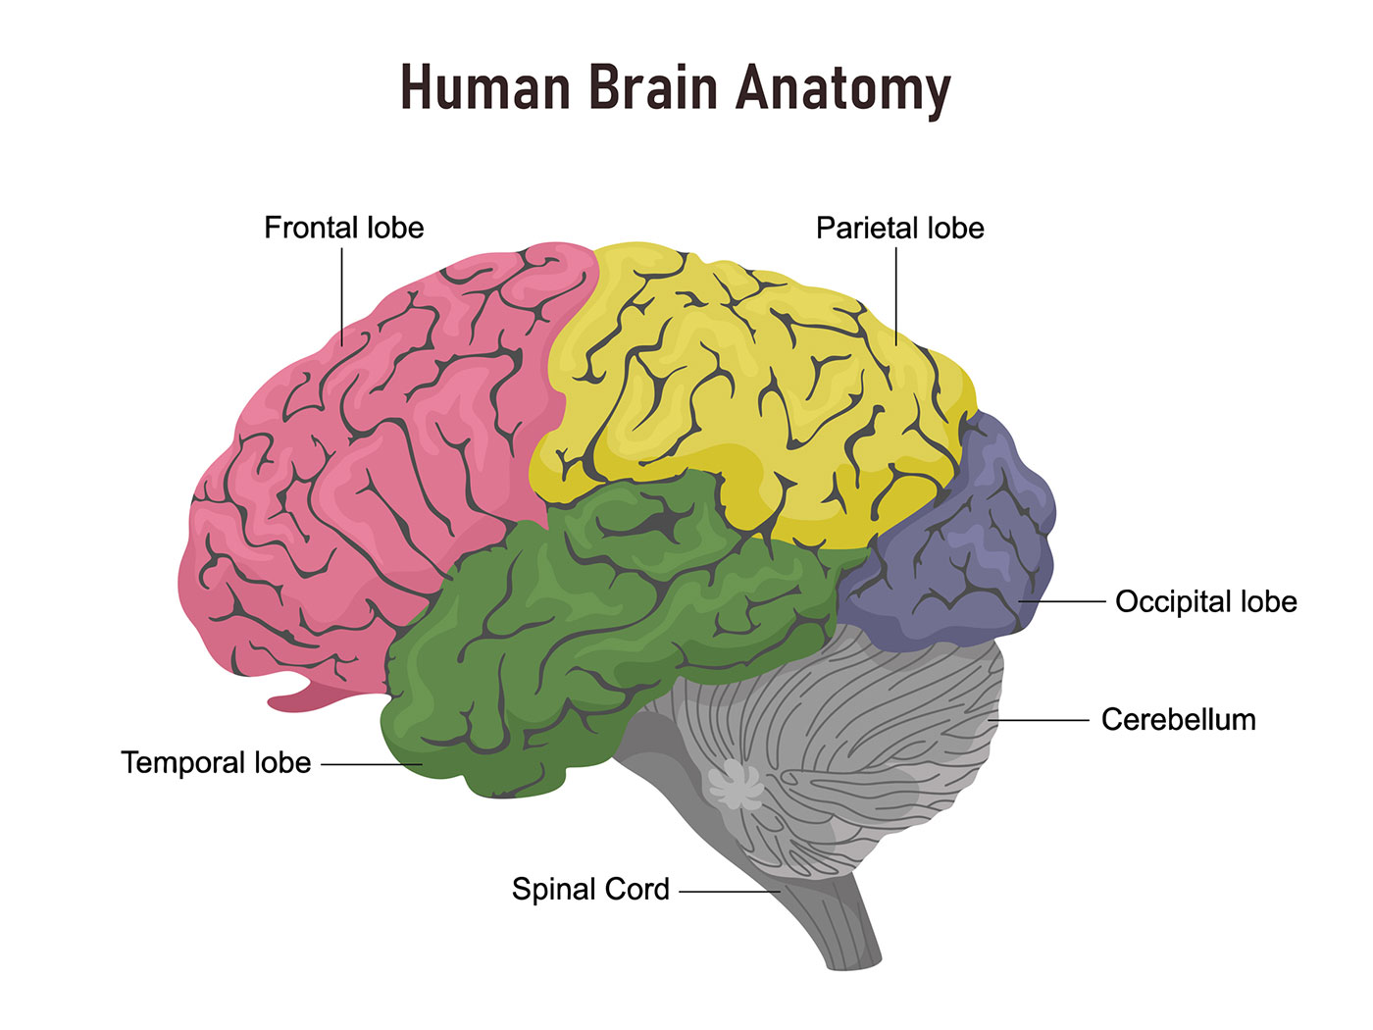
How is the brain structured?
Divided in Cerebrum and Cerebellum
Cerebrum has 4 lobes:
Frontal lobe
Parietal lobe
Temporal lobe
Occipital lobe
https://www.hopkinsmedicine.org/health/conditions-and-diseases/anatomy-of-the-brain

Slide 11
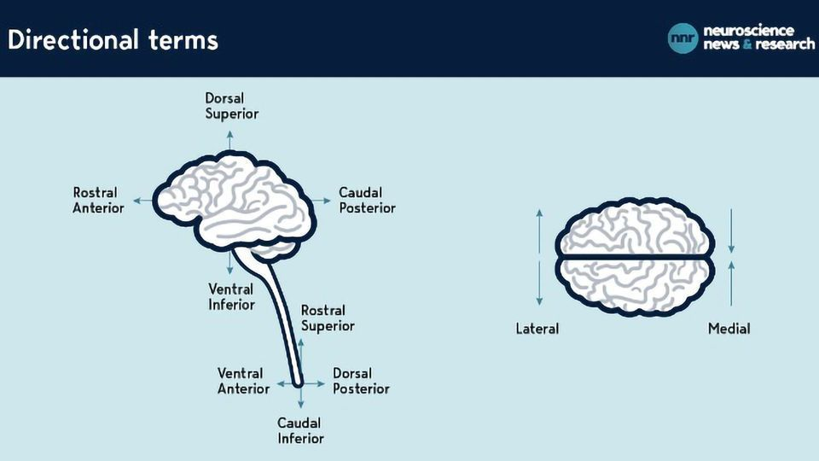
Orientation of the brain
To describe the brain, we have special terminology
https://www.technologynetworks.com/neuroscience/articles/navigating-the-brain-a-cheat-sheet-345665

Slide 12
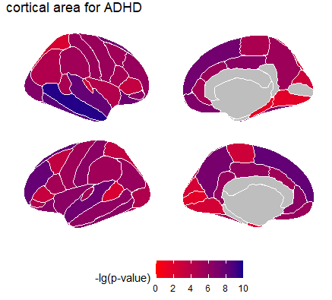
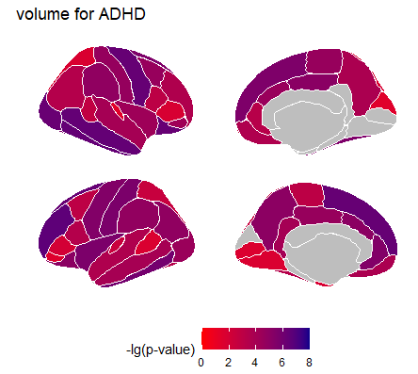
Results: structural MRI
reduced surface area in the brain
  right middle- and inferior-temporal gyrus
  left and right superior frontal gyrus
reduced volume
  left rostral middle frontal gyrus
  right middle temporal gyrus
  right inferior temporal gyrus
no significant differences in thickness and depth of the fissures

Slide 13
What are networks in our brain?
Different brain regions are communicating with each other to process information and
When special task are performed, or special information proceed specific region are active
  these regions form a functional network
The functional network we investigate are networks we can observed when the person is resting

Slide 14
Multivariate analysis: rs-fMRI
Reduction of network connectivity
  default and dorsal attention network
  dorsal ventral ad dorsal attention network
Increase of network connectivity
  default network and dorsal attention network
  cingulo-opercular network and default network
  dorsal attention network and ventral attention network

Slide 15
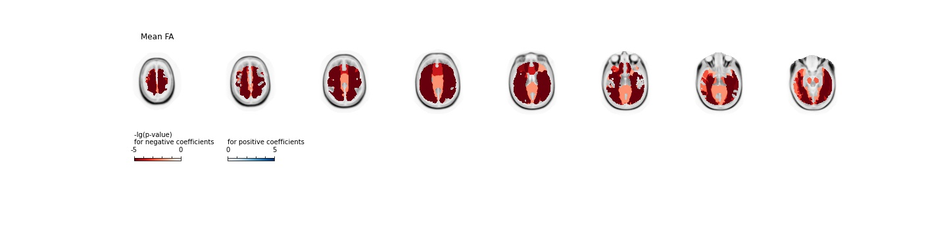
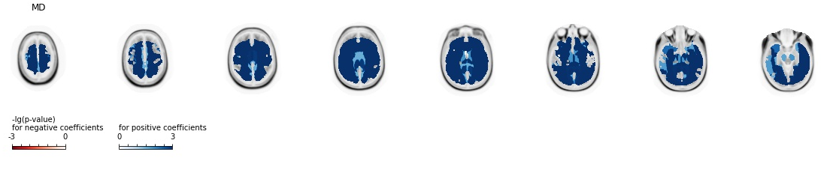
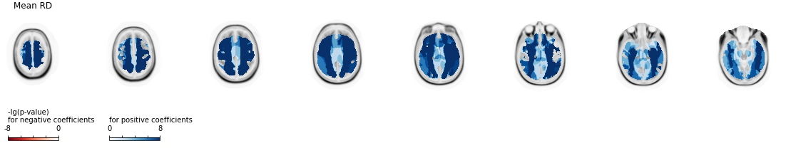
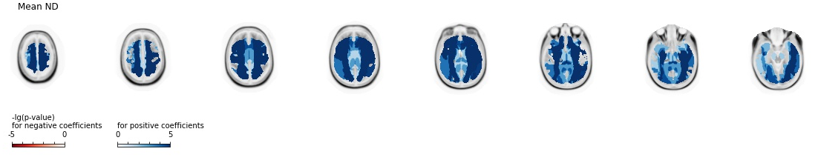
Multivariate analysis: DWI
Using different metrics generated from the Diffusion weighted imaging, we could identify an overall white matter changes

Slide 16
We could identify structural and functional alteration related to ADHD in Adolescents
Can we build a Predcitive model based on these findings?

Slide 17
Machine Learning (ML) algorithm with Feature Selection (FS) methods
Five ML algorithms with five FS methods
Bayesian Optimization for hyperparameter finetuning
  Finding the best numbers to make our machine learning algorithm to perform the best on the data
5 repeat 10-fold-CV
  To make sure we do not leave out information
Validated on an independent validation set
  To see if our trained ML algorithm can also predict using new data

Slide 18
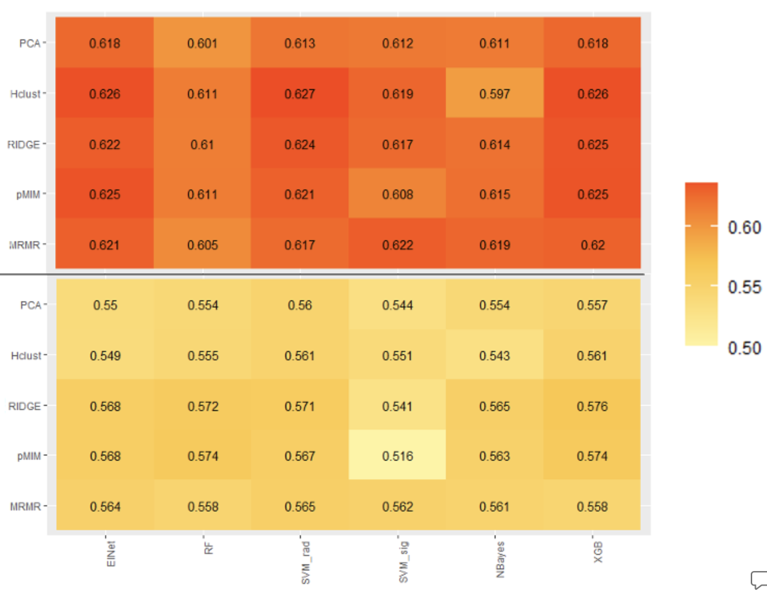
Prediction of ADHD
AUC was used to measure out classification model:
Best performance:
  Clinical/Radiomics: Support Vector Machine with radial kernel with Hierarchical Clustering (Hclust)
  Radiomics: eXtreme Gradient Boosting (XGB) and RIDGE regularized logistic regression (RIDGE) for feature selection
Predictions are 100% right: AUC= 1
Predictions are 100% wrong: AUC= 0

Slide 19
Conclusion
ADHD has neurostructural and -functional correlation
Social and environmental factors plays a role in the diagnostic of ADHD, but even without them a prediction is possible
  Supportive tool
Study at a populational level
  Highly selective patient cohorts in prior studies

Slide 20
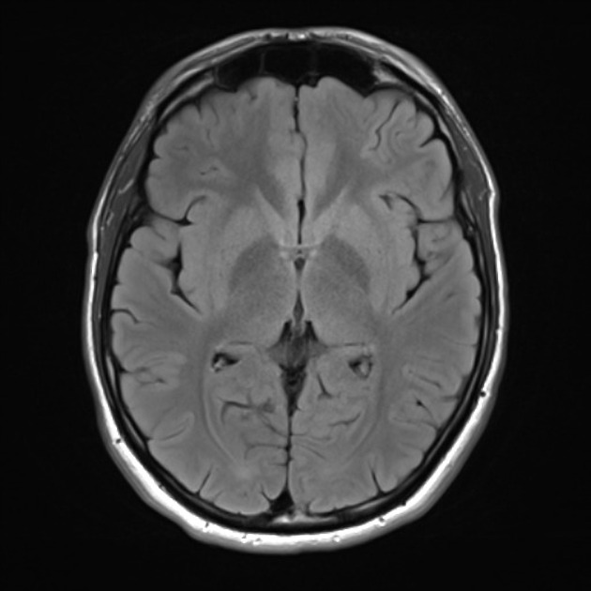
Thank you for your attention!
If you have any question, feel free to reach out to me!

