Slide 1
Did Patients with Cancer Receive Priority COVID-19 Vaccination?
Rahul N. Prasad, MD, MBA
12/2/2021

Slide 2
Disclosure
Department of Radiation Oncology, The Ohio State University Comprehensive Cancer Center
I have no conflicts to disclose

Slide 3
Learning Objectives
Investigate the consistency of prioritization of patients with cancer by states for COVID vaccination
Identify obstacles to adequate prioritization of this population
Discuss measures to mitigate these barriers through updated guidance for vaccination efforts

Slide 4
Agenda
Background
Methods
Results
Discussion
Conclusions

Slide 5
Background

Slide 6
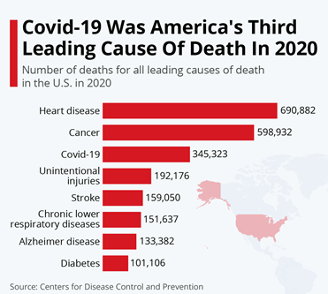
COVID-19 Incidence and Mortality
Responsible for >200 million cases and millions of deaths
Cancer associated with increased morbidity and mortality¹
CDC includes cancer as a high-risk medical condition

Slide 7
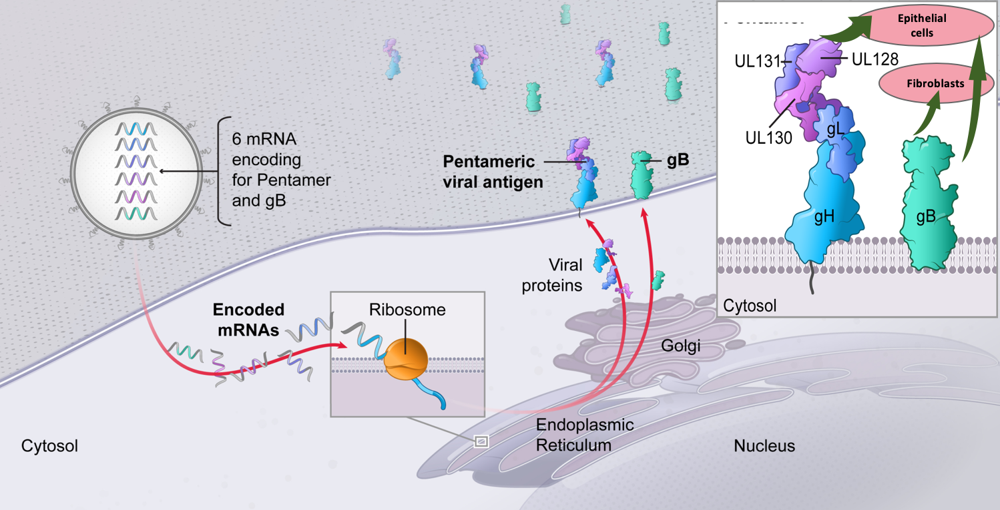
Vaccine Availability
Vaccines are highly effective against the original strains^{2,3}
However, initial supply limitations forced difficult patient prioritization decisions
Generic mechanism for mRNA vaccines (from Moderna)

Slide 8
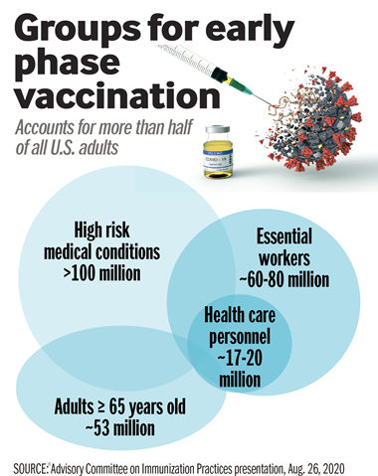
Vaccine Allocation
Federal guidelines recommended equal priority for patients 65+ and all adults with cancer
Faced with overwhelmingly large groups of equal priority, states triaged independently

Slide 9
Aims
The proportion of states that equally prioritized adults with cancer and the elderly for vaccination is unknown
We sought to characterize these crucial, state-level decisions
With concerns regarding delta and waning immunity,⁴ this unanswered question has resurfaced with increasing importance

Slide 10
Methods

Slide 11
Methods
In late February 2021, we identified every states’ COVID vaccination webpage through internet search
The proportion of states simultaneously vaccinating patients with cancer and patients 65+ was assessed
The proportion of states identifying a cancer diagnosis as a criteria for vaccination and the heterogeneity of definitions for a qualifying cancer diagnosis were evaluated
Descriptive statistics were performed

Slide 12
Results

Slide 13
Results
43 states included cancer as a criteria for vaccination
Over 80% did not precisely define a qualifying cancer diagnosis
Figure 1. Schematic demonstrating online availability of COVID-19 vaccine eligibility information for cancer patients at the state level. CDC = Centers for Disease Control and Prevention

Slide 14
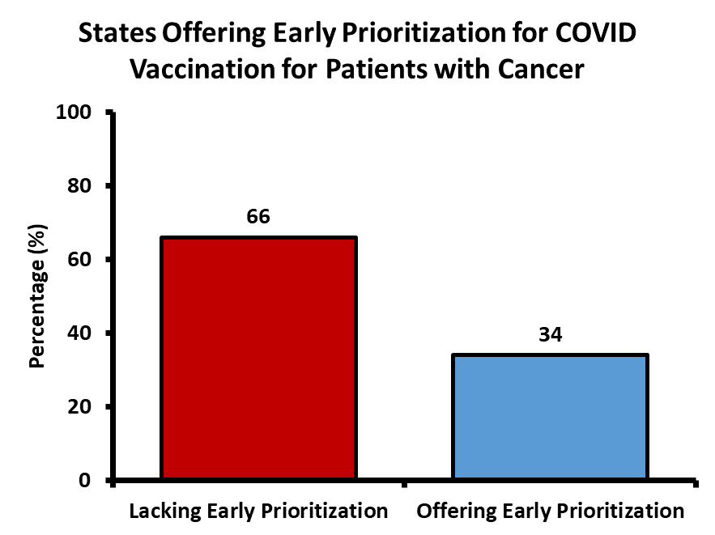
Results
2/3 of states did not adequately prioritize patients with cancer
No relationship to per capita cancer prevalence
Finding detailed vaccination information required significant computer literacy
Figure 2. Proportion of US states offering equivalent early prioritization for COVID vaccination for patients with cancer and patients over the age of 65

Slide 15
Discussion

Slide 16
Potential Explanations
Desire to simplify vaccination efforts
Intention to minimize waste/delays
Prohibitively broad recommended inclusion criteria

Slide 17
Possible Interventions
Target highest risk subpopulations with narrower inclusion criteria
Prioritize vaccination of patients with multiple comorbidities
Prioritize at-risk socioeconomic or racial/ethnic populations

Slide 18
Conclusions

Slide 19
Conclusions
Equitable booster immunization is essential to minimizing inequitable COVID-related outcomes
~2/3 of states did not adequately prioritize patients with cancer during phase 1c
Booster guidelines may again inadvertently delay immunization for at-risk subgroups
Redefining criteria for expedited boosters may alleviate these concerns

Slide 20
Acknowledgements
Dr. Joshua D. Palmer (OSU Radiation Oncology) for his outstanding mentorship
The OSU Department of Radiation Oncology and Residency Program for their support including:
Dr. Raju R. Raval, Program Director
Dr. Julia White, Vice Chair Clinical Research, Department of Radiation Oncology
Dr. Arnab Chakravarti, Chair, Department of Radiation Oncology

Slide 21
References
1. Ribas A, Sengupta R, Locke T, et al. Priority COVID-19 Vaccination for Patients with Cancer while Vaccine Supply Is Limited. Cancer Discov. 2021;11(2):233-236. doi:10.1158/2159-8290.CD-20-1817
2. Polack FP, Thomas SJ, Kitchin N, et al. Safety and Efficacy of the BNT162b2 mRNA Covid-19 Vaccine. New England Journal of Medicine. 2020;383(27):2603-2615. doi:10.1056/NEJMoa2034577
3. Baden LR, El Sahly HM, Essink B, et al. Efficacy and Safety of the mRNA-1273 SARS-CoV-2 Vaccine. New England Journal of Medicine. 2021;384(5):403-416. doi:10.1056/NEJMoa2035389
4. Bar-On YM, Goldberg Y, Mandel M, et al. Protection of BNT162b2 Vaccine Booster against Covid-19 in Israel. N Engl J Med. Published online September 15, 2021. doi:10.1056/NEJMoa2114255

Slide 22
Rahul.Prasad@osumc.edu

