Slide 1
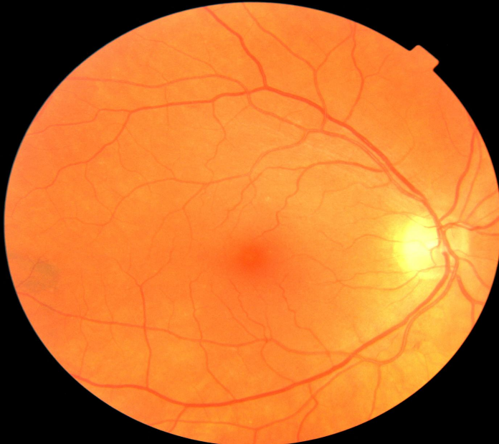
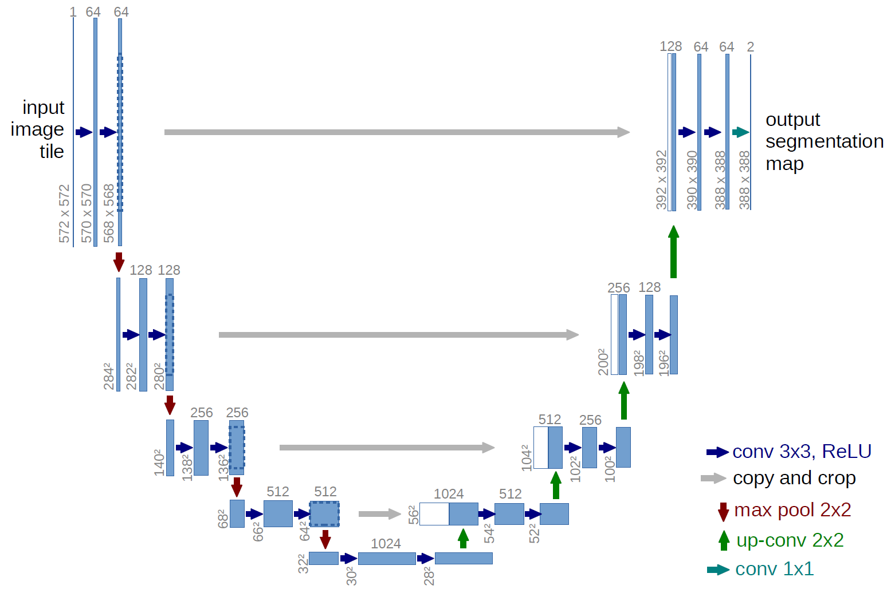
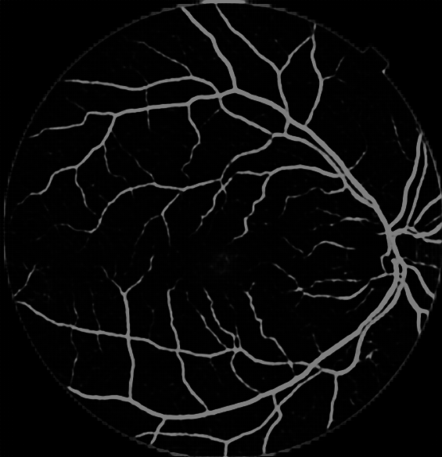
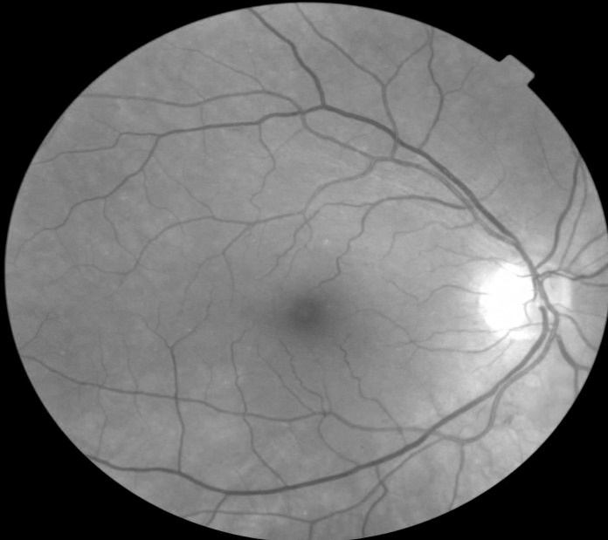
Machine Learning for Parkinson’s Disease Diagnosis using Fundus Eye Images
Maximillian Diaz¹, Jianqiao Tian¹ , Adolfo Ramirez-Zamora², and Ruogu Fang¹
¹J. Crayton Pruitt Family Department of Biomedical Engineering, University of Florida, Gainesville, FL
²Center for Movement Disorders and Neurorestoration, University of Florida, Gainesville, FL
Introduction
DATA SETS
Parkinson Disease (PD) is the second most common neurodegenerative disease
PD is diagnosed by the presence of resting tremors, muscle stiffness, and slowness
Symptoms occur late in the disease progression
PD has been shown to affect eye blood vessels
UKB Data Set
Images from United Kingdom Biobank (UKB)
UF-UKB Data Set
Data collected at UF with a Remidio FOP
UKB used for age-gender balanced images
Table 1 | UKB Dataset Demographics
Demographic | Value
Mean Age | 60.9
Standard Deviation of Age | 6.4
CN Images | 238
PD Images | 238
Total images | 476
Table 2 | UF-UKB Dataset Demographics
Demographic | UF | UKB | Total
Mean Age | 37.6 | 66.3 | 44
Standard Deviation of Age | 23.5 | 9.6 | 22.5
CN Images | 28 | 44 | 72
PD Images | 72 | 0 | 72
Total Images | 100 | 44 | 144
RGB Image Network Flow
Green Channel Image Network Flow
SVM
Classifier
PD
or
CN
SVM
Classifier
PD
or
CN
Original Image
UNet Network
Vessel Segments
Original Image
Green Channel
UNet Network
Vessel Segments
RESULTS
CONCLUSION
Table 3 | Performances of networks trained on UKB and UKB-Green
Method | Accuracy(%) | Sensitivity(%) | Specificity(%)
UKB Linear | .698 | .625 | .771
UKB Sigmoid | .698 | .750 | .646
UKB RBF | .635 | .729 | .541
UKB-Green Linear | .688 | .604 | .771
UKB-Green Sigmoid | .719 | .792 | .646
UKB-Green RBF | .656 | .680 | .625
Linear SVM
Sigmoid SVM
RBF SVM
The results indicate that the proposed machine learning classifies PD based on retina vasculature
The proposed method shows that the key features are smaller blood vessels
Machine learning classifiers can be applied to clinically available data and provide accurate predictions
The proposed methods further supports the idea that changes in brain physiology can be observed in the eye
The use of single-color channels can improve performance.
UKB
UKB
Green
UF-UKB
Table 4 | Network performances from UF-UKB and UF-UKB-Green
Method | Accuracy (%) | Sensitivity(%) | Specificity(%)
UF-UKB Linear | .821 | .786 | .857
UF-UKB Sigmoid | .786 | .786 | .786
UF-UKB RBF | .786 | .786 | .786
UF-UKB-Green Linear | .857 | .786 | .929
UF-UKB-Green Sigmoid | .821 | .786 | .857
UF-UKB-Green RBF | .821 | .786 | .857
UF-UKB
Green
REFERENCE
[1] L. M. de Lau and M. M. Breteler, "Epidemiology of Parkinson's disease," The Lancet Neurology, vol. 5, no. 6, pp. 525-535, June 2006.
Figure 3 | Saliency maps illustrating the regions of importance determined by the SVM
J. Crayton Pruitt Family Department of Biomedical Engineering

