Slide 1
Machine Learning for Parkinson’s Disease Diagnosis using Fundus Eye Images
Maximillian Diaz¹, Jianqiao Tian¹, Adolfo Ramirez-Zamora, MD^{2,} Ruogu Fang, PhD¹
1. J. Crayton Pruitt Family Department of Biomedical Engineering, University of Florida, Gainesville, FL
2. Center for Movement Disorders and Neurorestoration, University of Florida, Gainesville, FL

Slide 2
What is Parkinson’s Disease
Parkinson’s Disease (PD) is pathologically defined by the loss of dopaminergic neurons in the substantia nigra [1].
Clinical standard for diagnosing PD is the presence of tremors and muscle stiffness and slowness
Symptoms develop after prolonged progression with significant injury to dopamine brain neurons
Current research is focusing on identifying diagnosis with nonmotor symptoms
Cardiac arrhythmias, sleep disorders, constipation, vocals, and gait [3].
[1] L. M. de Lau and M. M. Breteler, "Epidemiology of Parkinson's disease," The Lancet Neurology, June 2006.
[2] S. Sveinbjornsdottir, "The clinical symptoms of Parkinson's disease," Journal of Neurochemistry, July 2016.
[3] K. R. Chaudhuri, D. G. Healy and A. H. Schapira, "Non-motor symptoms of Parkinson's disease: diagnosis and management," The Lancet Neurology, Mar. 2006.
Notes:
https://www.researchgate.net/figure/Location-of-the-substantia-nigra-in-the-mesencephalon-transverse-view-The-SN-is_fig1_225242566
https://medlineplus.gov/ency/imagepages/19515.htm

Slide 3
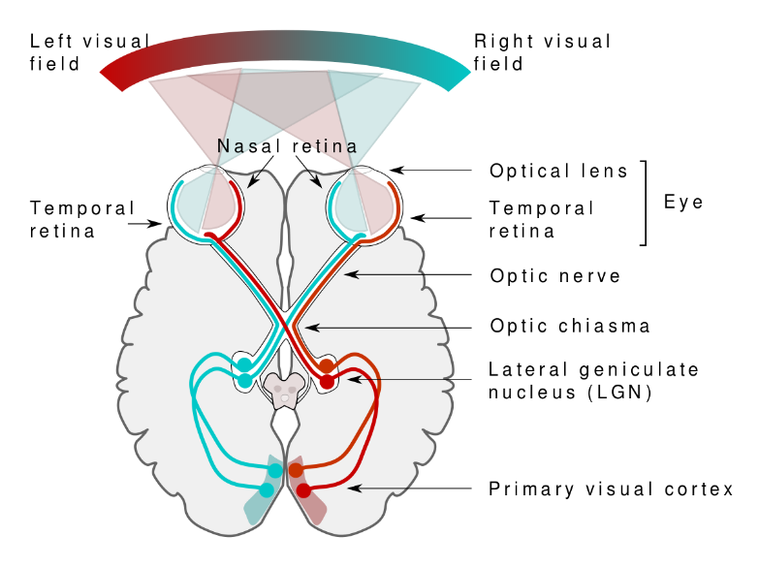
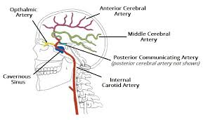
The Eye and the Brain
The optic nerves send signals from the eye to the brain, and are the only two major nerves that can be seen without cutting someone open [4]
Lack of dopamine in the eyes leads to a thinning of eyes layers which can be seen with Optical coherence tomography (OCT) imaging [5].
The small blood vessels in the eye shrink with PD progression [6].
Source: https://en.wikipedia.org/
Source: https://teachmeanatomy.info/
[4] D. Das et. al, "Optic nerve anatomy for future human biometric," Advances in Ophthalmology & Visual System, Mar. 2018.
[5] E. Garcia-Martin et. al, "Distribution of Retinal Layer Atrophy in Patients With Parkinson Disease and Association With Disease Severity and Duration," American Journal of Ophthalmology, Feb. 2014.
[6] W. R. Kwapong et. al, "Retinal Microvascular Impairment in the Early Stages of Parkinson's Disease," Investigative Ophthalmology & Visual Science, Aug. 2018.
Notes:
https://www.medicalnewstoday.com/articles/326621#diagram
https://synapse.koreamed.org/ViewImage.php?Type=F&aid=50902&id=F1&afn=161_NRP_11_5_381&fn=nrp-11-381-g001_0161NRP
http://www.meddean.luc.edu/lumen/meded/neuro/neurovasc/navigation/ica.htm

Slide 4
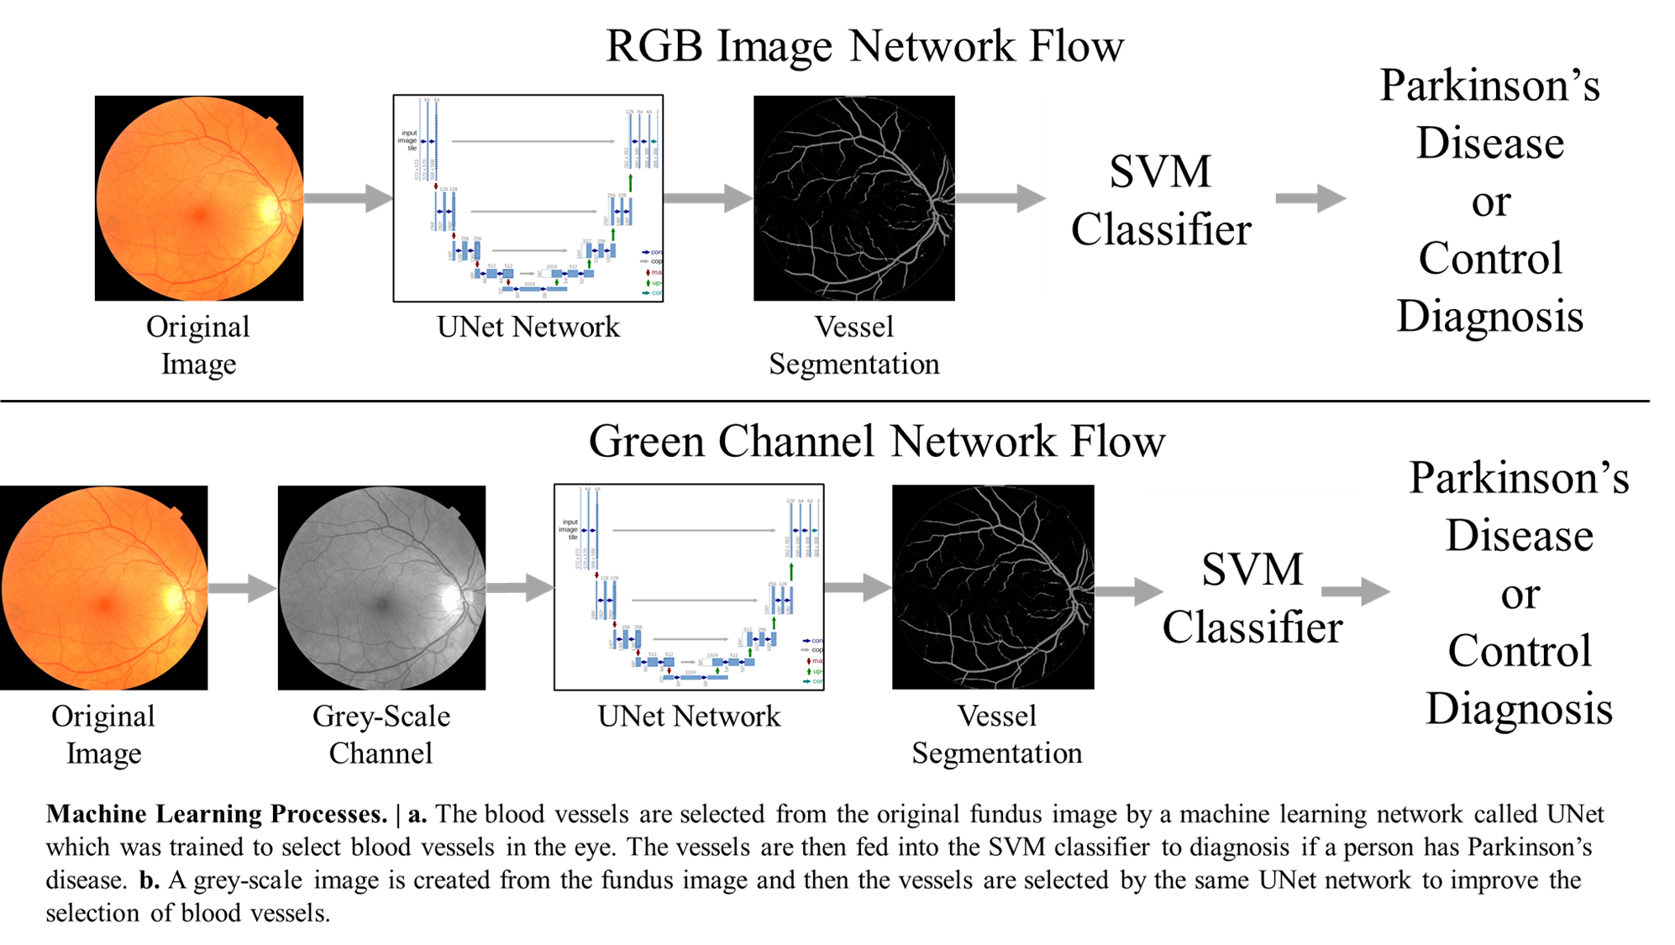
Machine Learning Process

Slide 5
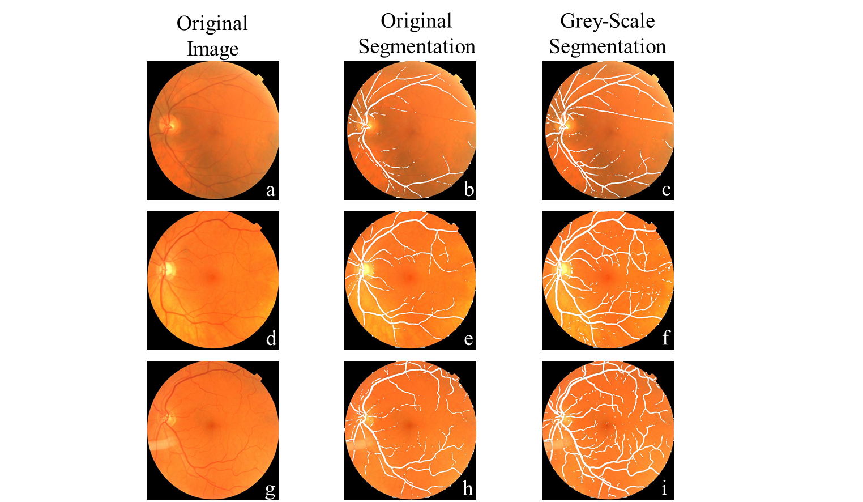
Why Grey-Scale Images?
[7] C. Zhu et. al, "An Ensemble Retinal Vessel Segmentation Based on Supervised Learning in Fundus Images," Chinese Journal of Electronics, Aug. 2016.

Slide 6
Vessel Segmentation
A vessel selection was developed using the U-net architecture.
Trained on the Digital Retinal Images for Vessel Extraction (DRIVE) database.
The DRIVE dataset contains 40 retina fundus images
The resulting network performs automated vessel segmentation.

Slide 7
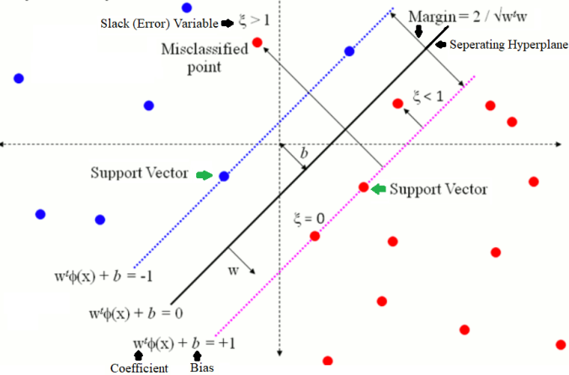
What is SVM?
Source: https://lmb.informatik.uni-freiburg.de/people/ronneber/u-net/
Notes:
https://lmb.informatik.uni-freiburg.de/people/ronneber/u-net/

Slide 8
Support Vector Machine (SVM)
80% of the data for the development, 20% for testing
Trained using fivefold cross validation.
Kernels: Linear, Sigmoid, RBF
Source: https://towardsdatascience.com
Notes:
https://towardsdatascience.com/support-vector-machine-simply-explained-fee28eba5496

Slide 9
Machine Learning Process

Slide 10
UK Biobank (UKB) Dataset
UK Biobank it is not a disease specific database.
Data from 2,268 Parkinson’s patients
87,569 left fundus images and 88,255 right fundus images
Age and Gender matched PD and CN images
Evenly split images between both eyes
Demographics for UKB Dataset
Mean Age | 60.97
Standard Deviation of Age | 6.35
CN Images | 238
PD Images | 238
Total images | 476

Slide 11
UF-UKB Dataset
Images collected from PD patients at the University of Florida, Fixel Neurological Institute, Movement Disorders Center
Selected 72 PD images and 28 CN images from the UF data
44 CN images taken from the UKB.
Demographics for UF-UKB Dataset
 | UF | UKB | Total
Mean Age | 66.3 | 66.3 | 66.3
Standard Deviation of Age | 9.63 | 9.63 | 9.63
CN Images | 28 | 44 | 72
PD Images | 72 | 0 | 72
Total Images | 100 | 44 | 144

Slide 12
UKB Results
Method | Accuracy | Sensitivity | Specificity | AUC
UKB Linear | .698 | .625 | .771 | .74
UKB Sigmoid | .698 | .75 | .646 | .74
UKB RBF | .635 | .729 | .541 | .72
UKB-Green Linear | .6875 | .604 | .771 | .71
UKB-Green Sigmoid | .719 | .792 | .646 | .71
UKB-Green RBF | .656 | .6875 | .625 | .68

Slide 13
UF-UKB Results
Method | Accuracy | Sensitivity | Specificity | AUC
UF-UKB Linear | .821 | .786 | .857 | .85
UF-UKB Sigmoid | .786 | .786 | .786 | .87
UF-UKB RBF | .786 | .786 | .786 | .82
UF-UKB-Green Linear | .857 | .786 | .929 | .89
UF-UKB-Green Sigmoid | .821 | .786 | .857 | .89
UF-UKB-Green RBF | .821 | .786 | .857 | .90

Slide 14
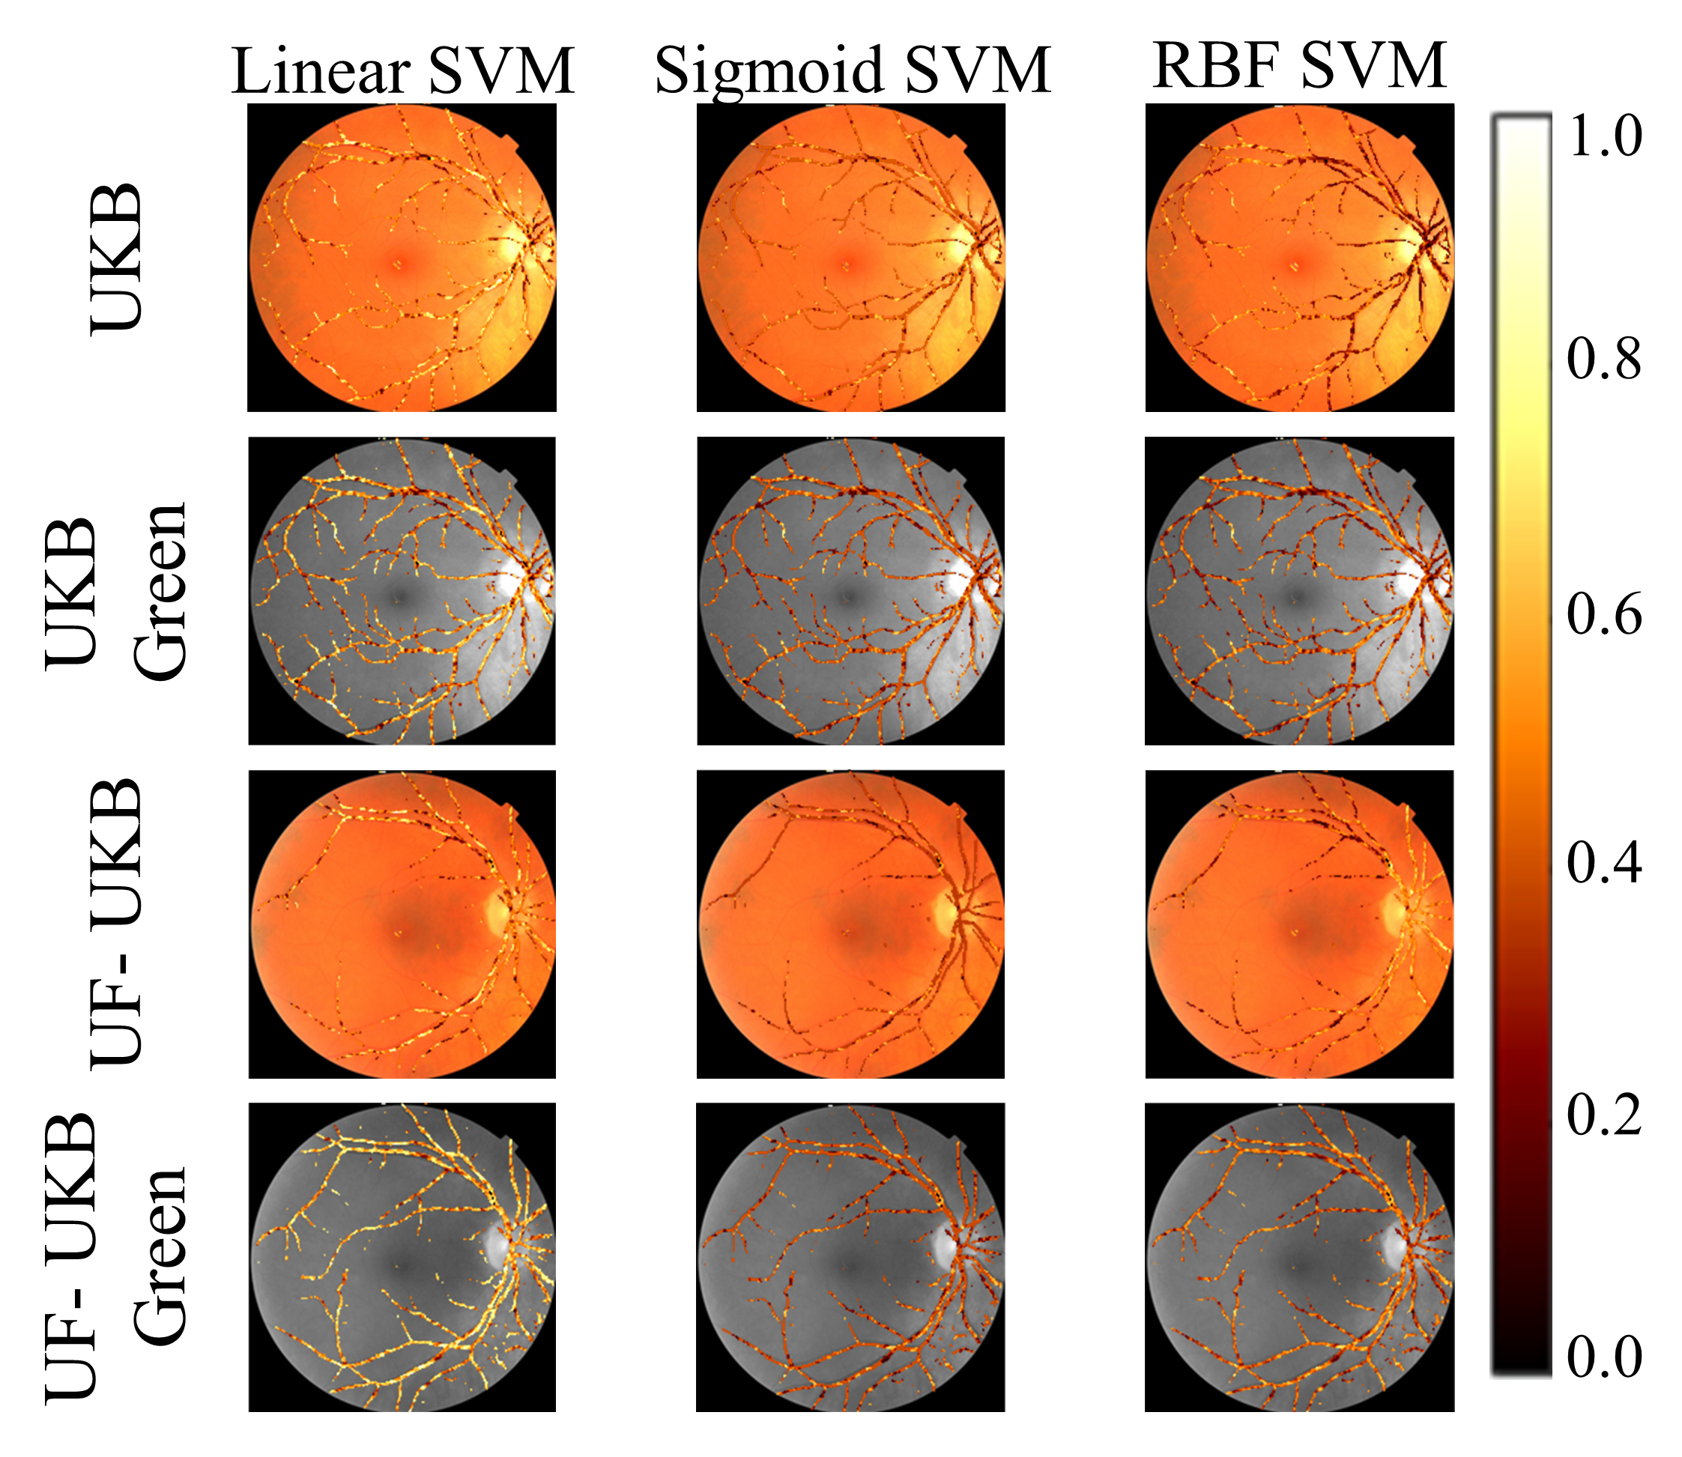
Saliency Map

Slide 15
Conclusions
Machine learning can classify Parkinson’s disease using eye images
The results indicate that the key features are smaller blood vessels
Machine learning can be applied to clinically available data
The proposed methods further support the idea that changes in brain physiology can be observed in the eye

Slide 16
Limitations and Future Work
Currently cannot perform early diagnosis with retina vasculature
Development of a long-term study program which incorporates fundus images
Clinically collected database used in this work is still limited in size and demographics.
Continued development of a clinical dataset
Saliency maps cannot provide full details on the biomarkers that it is identifying.
Larger dataset to identify a correlation between regions of interest

Slide 17
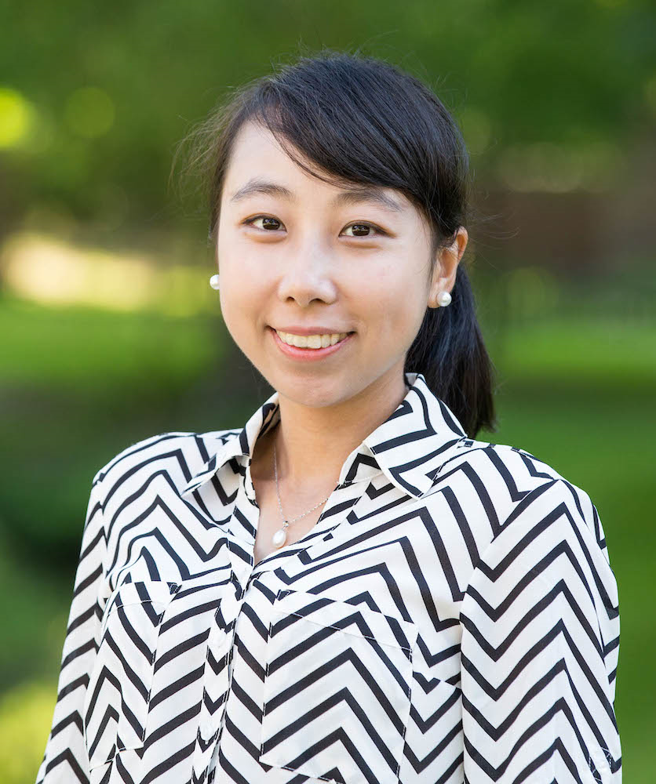
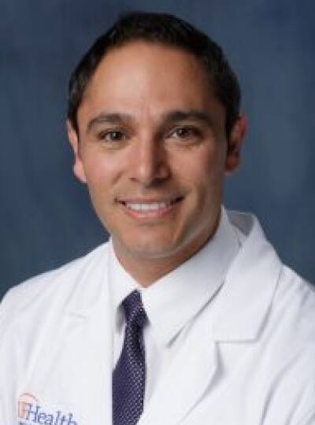
Acknowledgements
Ruogu Fang, PhD
Advisor
Jianqiao Tian
Graduate Mentor
Adolofo Ramirez, MD Clinical Collaborator

Slide 18
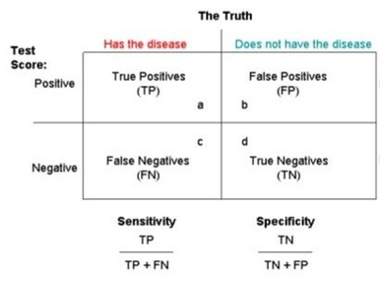
Sensitivity and Specificity
Notes:
https://www.bettervisionguide.com/diabetic-retinopathy-treatments/

