Slide 1
RSNA 2018 Annual Meeting, Chicago
Generative Neural Network Inserting or Removing Cancer into Mammograms Fools Radiologists and Deep Learning Alike: Example of an Adversarial Attack
A. S. Becker¹⁾, L. Jendele²⁾, O. Skopek²⁾, S. Ghafoor¹⁾, N. Berger¹⁾, M. Marcon¹⁾, E. Konukoglu³⁾
¹⁾ Institute of Diagnostic and Interventional Radiology, University Hospital of Zürich
²⁾ Department of Computer Science, ETH Zürich
³⁾ Department of Information Technology and Electrical Engineering, ETH Zürich
Notes:
16:9!! DIR Vorlage?

Slide 2
Agenda
Disclosures: None
Background: Generative Adversarial Networks (GANs)
Methods
Results: Readout
Summary and Conclusion
Questions
Breast-GAN / Anton S. Becker / USZ Diagnostic and Interventional Radiology
November 2018
Notes:
Struktur weglassen
Purpose!!

Slide 3
Background
Generative Adversarial Networks
Principle: Two Neural Networks competing against each other
Generator (G)
Discriminator (D)
Like a game of police vs. a gangster printing fake money
Police learns to spot fake money
With enough time, the gangster learns to print perfect fake money
In our case: The first network (G) learns to make perfect fake mammograms
Korkinof et al., arXiv:1807.03401
Breast-GAN / Anton S. Becker / USZ Diagnostic and Interventional Radiology
November 2018

Slide 4
Methods
Patient Cohort/Image Data
Two publicly available datasets: BCDR and INBreast.
For INBreast: BI-RADS 4/5 treated as ‘malignant’, BI-RADS 1-3 ‘benign’
680 mammograms from 334 patients. Cancer on 318 images.
37 images had been removed (poor quality)
Breast-GAN / Anton S. Becker / USZ Diagnostic and Interventional Radiology
November 2018
Notes:
Evtl. noch was zu BI-RADS vs. Histology sagen

Slide 5
Methods
Readout
40 real mammograms and 40 fake mammograms were shown to three radiologists
They were not told which cases were real and which were fake
The radiologists had to tell whether there was cancer in the image AND
whether the image was fake or real
Real image (no cancer)
Same image but
with fake cancer
Breast-GAN / Anton S. Becker / USZ Diagnostic and Interventional Radiology
November 2018
Notes:
Bilder croppen, grösser machen, während Präsi zeigen

Slide 6
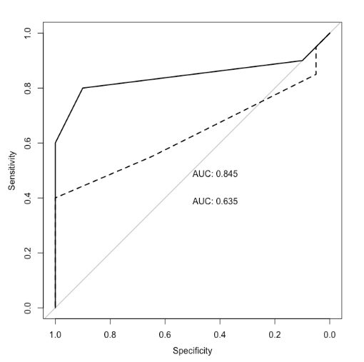
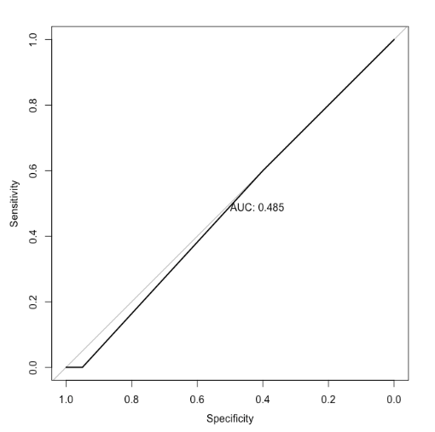
Results
Cancer or no cancer? Fake or real?
The solid line shows the performance of one radiologist on the real data, and the dashed line shows worse performance on the fake data (i.e. confusion of healthy for cancer and vice versa)
This line shows that the radiologist basically could not tell whether the image was fake or real. An AUC of nearly 0.5 (=50%) corresponds to a coin-flip chance of guessing.
Breast-GAN / Anton S. Becker / USZ Diagnostic and Interventional Radiology
November 2018
Notes:
AUC grösser, ROC‘s beschriften, Linien Legende

Slide 7
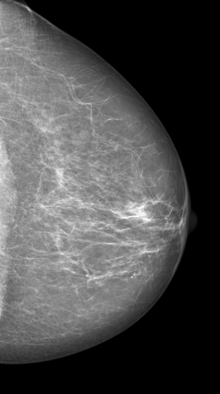
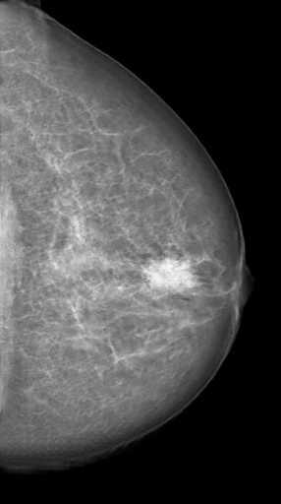
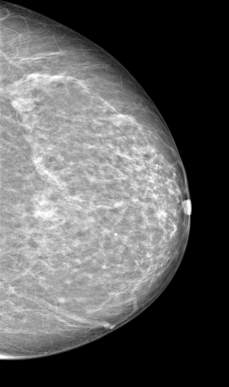
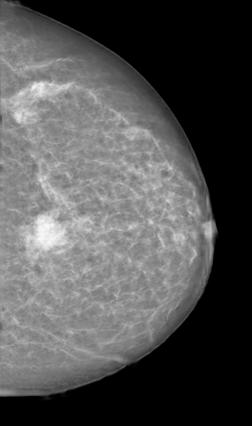
More Examples
Healthy (original)→Cancer (fake) Healthy (orig.). → Cancer (fake)
Breast-GAN / Anton S. Becker / USZ Diagnostic and Interventional Radiology
November 2018

Slide 8
Summary
Neural networks can inject or remove malignant features into mammographic images.
Modern adversarial attacks may go undetected by humans as well as computers.
These fake cancers may lead to false diagnoses.
It is important to secure hospital devices and networks against attacks by neural networks.
Breast-GAN / Anton S. Becker / USZ Diagnostic and Interventional Radiology
November 2018
Notes:
Ballone statt Mammo

Slide 9
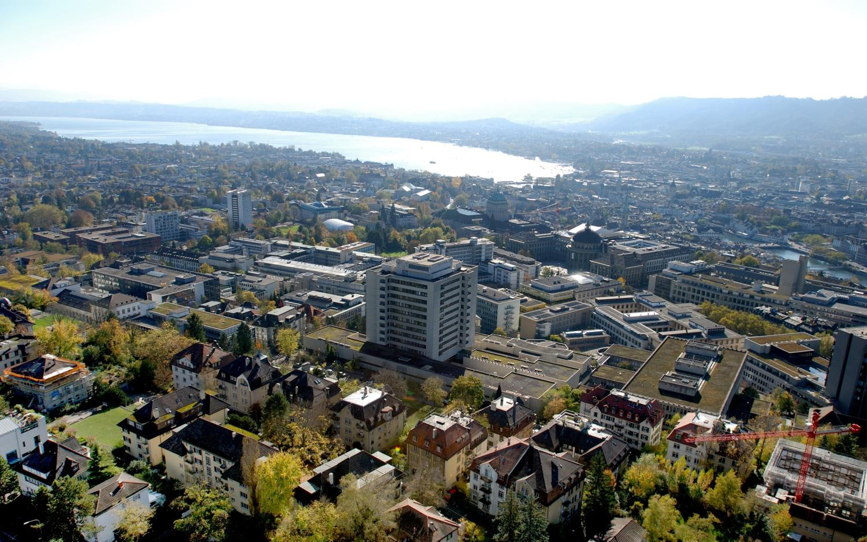
Questions?
anton.becker@usz.ch
Thank you for your attention!
Breast-GAN / Anton S. Becker / USZ Diagnostic and Interventional Radiology
November 2018

